Slide 1





SHOP
EPAM DWH PROJECT 2025

Slide 2

Business background
Coffee is a daily necessity for many people around the world. Our business operates both physical coffee shops and an online store,offering beverages,snacks and bakery items. As competition in the coffee market grows, understanding customer preferences and product performance is crucial.To succeed, it’s important to collect and analyze sales data using modern tools.
Problems because of poor data management
The business cannot track what products are performing well or understand customer behaviour.
Poor decision-making,missed opportunities and reduces competitiveness.
Hard to plan promotions or tailor services to customer needs.
Benefits from implementing a Data Warehouse?
It allows the business to answer key questions such as:
Which products sell best in each country or city?
How do promotions and loyalty programs affect sales?
What customer segments generate the most profit?
Further benefits include:
Better stock and staff management.
Improved marketing strategies.
More personalized customer experience.

Slide 3






Dataset Description
STAFF
STORES
CUSTOMERS
PRODUCTS
PAYMENTS
DATES
staff_id (PK)
staff_first_name
staff_last_name
staff_job_title
Job_start_date
hourly_wage
employment_status (e.g., active, leave)
store_id (PK)
store_name
store_city
store_country
store_address
store_floor_area
store_type (e.g., mall, standalone)
website
customer_id (PK)
customer_first_name
customer_last_name
customer_country
loyalty_member
loyalty_discount
gender
birth_year
signup_dt
product_id (PK)
product_group
product_category
product_type
product_name
promo_flag
promo_discount
base_price
is_limited_edition
payment_id (PK)
payment_method (e.g., Card, Wallet, Cash)
payment_provider (e.g., Visa, PayPal)
transaction_fee_rate
is_contactless
date_id (PK)
day_of_week
day_of_month
week_id
month_id
month_name
quarter_id
quarter_name
year_id
is_weekend

Slide 4


GRAIN/DIMENSIONS/FACTS
Analyze retail sales transactions, both offline and online, across different products, customers, stores, dates, and payment methods.
Each row in the sales table represents a line item in a transaction: the sale of a specific product in a specific quantity to a specific
store using a specific payment.
1.BUSINESS PROCESS
2.GRAIN
3.DIMENSIONS
4.FACTS
Date,
Customer,
Product,
Store,
Staff,
Payments
Sales fact table
Quantity,
Line Item Amount,
Cost,
Profit,
Profit Margin,
Delivery Fee

Slide 5


Business Layer 3NF
3NF Design Process
Relationships were modeled according to business rules.
Surrogate keys were assigned as primary keys for all tables to ensure unique identification. Natural keys from source data were preserved as source IDs.
Normalization
All tables comply with 3NF by ensuring that:
Each attribute is atomic (1NF).
All non-key attributes fully depend on the primary key (2NF).
No transitive dependencies exist, attributes depend only on the primary key (3NF).
This structure eliminates redundancy and supports efficient updates and queries.

Slide 6


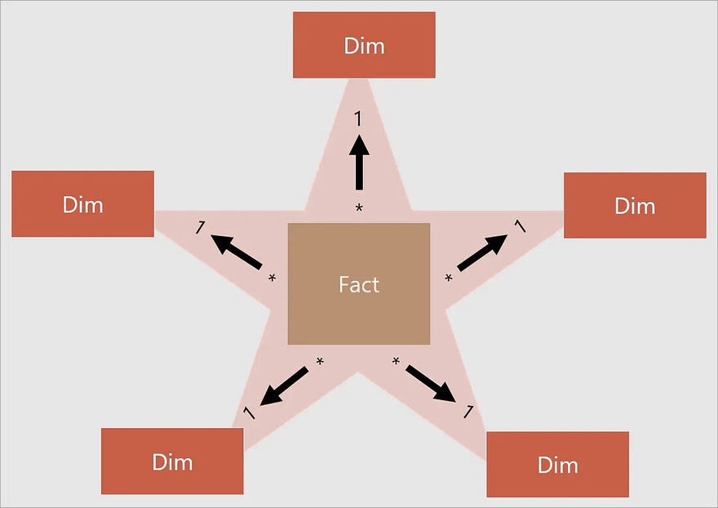

Business Layer Dimensional Model
Star Schema Design
Business Benefits
Our coffee shop dimensional model follows a star schema approach optimized for analytical queries and reporting:
Fast Query Performance - Star schema enables rapid aggregations for daily sales reports
Intuitive Structure - Business users can easily understand and navigate the model
Historical Tracking - Slowly Changing Dimensions (SCD) preserve historical context

Slide 7






Logical Scheme
BACK ROOM
FRONT ROOM
DATA SOURCE
STAGING AREA
3NF RELATIONAL LAYER
DIMENSIONAL LAYER
DATA MARTS
USERS
MARKETING
REPORTING
ANALYSIS
DATA MINING
SALES
ANALYTICS
online_coffee_shop_transactions.csv
offline_coffee_shop_transactions.csv
ext_online_coffee_shop_transactions
ext_offline_coffee_shop_transactions
src_online_coffee_shop_transactions
src_offline_coffee_shop_transactions
ce_staff
ce_products
ce_customers_scd
ce_sales
...
Fact Table - FCT_SALES_DD
Quantitative metrics,
foreign keys to dimensions,
lowest grain
user generated data
Raw data, Populated src tables using
foreign tables(ext)
Dimensions - DIM_CUSTOMERS_SCD,
DIM_PRODUCTS,DIM_DATES, DIM_PRODUCTS,DIM_STAFF
Normalized tables
Descriptive data,
surrogate keys,
slowly changing dimensions (SCD)
--------------------------------------------------------------METADATA--------------------------------------------------------------

Slide 8
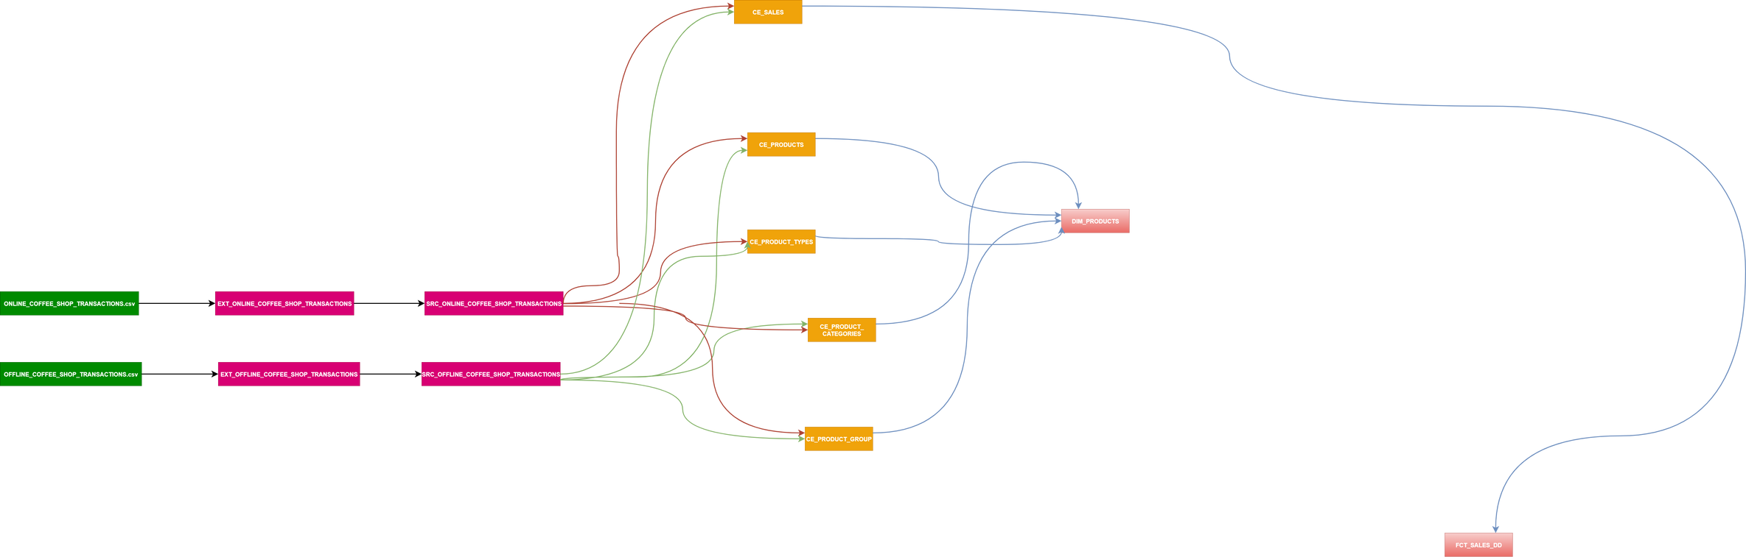
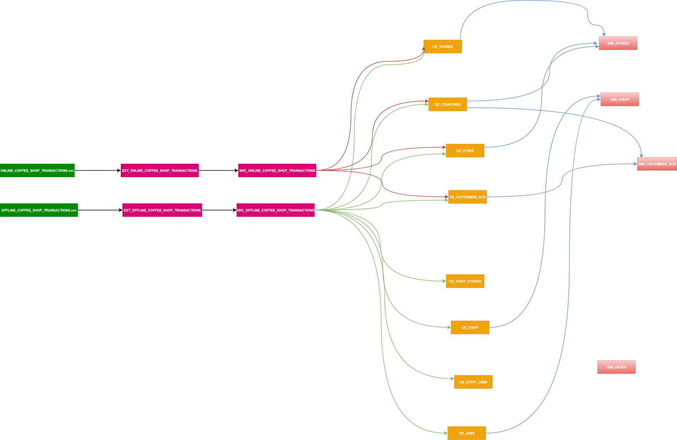
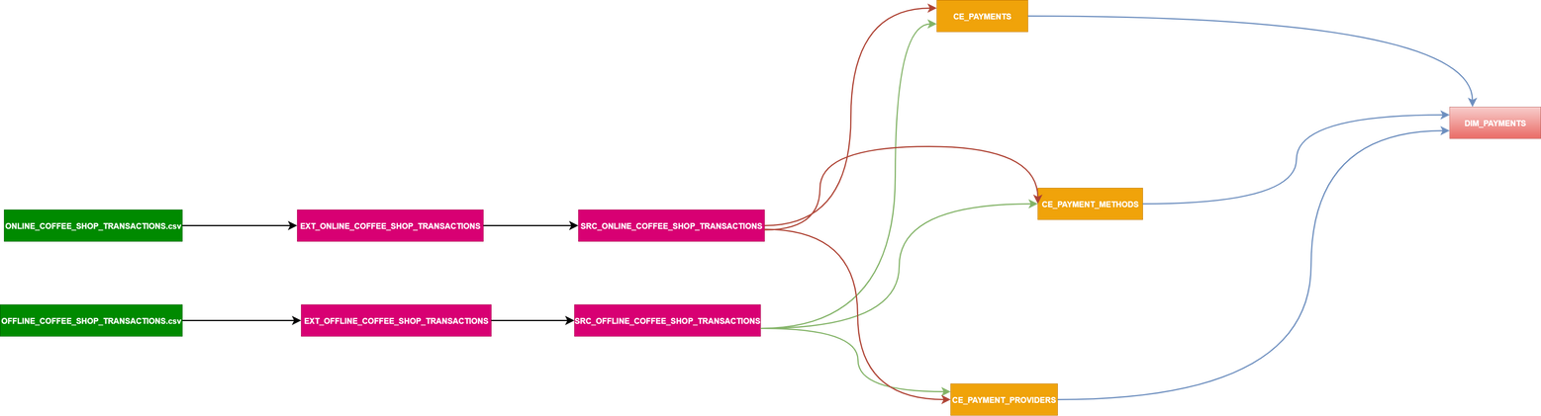
Data Flow

Slide 9
Fact Table Partitioning Strategy
The fact table BL_DM.FCT_SALES_DD is range-partitioned by the "EVENT_DT" column (of type BIGINT, formatted as YYYYMMDD). This partitioning strategy ensures optimized query performance and efficient data management over time, especially for time-series analytical workloads.
The partitioning logic consists of the following components:
Archive Partition:
A separate partition named fct_sales_dd_archive stores all records older than three months from the current date. This allows for archival of historical data while keeping the active partitions smaller and faster to query.
Rolling Monthly Partitions:
The main table is dynamically partitioned by month using a rolling window approach:
Partitions are created for 3 months in the past and 1 month in the future relative to the current month.
Partition names follow the format fct_sales_dd_YYYYMM, e.g., fct_sales_dd_202504.
Each partition covers a specific monthly range using FOR VALUES FROM (...) TO (...) with EVENT_DT as the partitioning key.
This strategy improves performance in the following ways:
Minimizes the size of each partition.
Enables efficient pruning of partitions during query execution.
Supports scalable ETL operations through partition-aware loading.
Simplifies data retention policies (e.g., easy to detach or truncate older partitions).
This approach aligns with best practices for managing large volumes of time-based transactional data in a Data Warehouse environment.

Slide 10


Thank You

